Slide 1
A Tutorial of
MongoDB III
MIS 634
Business Intelligence & Data Integration - LAB

Slide 2
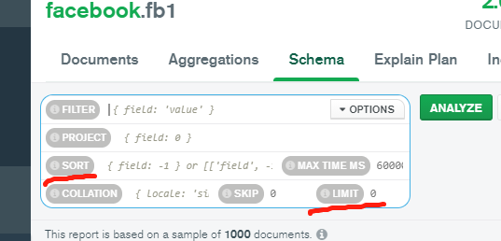
MongoDB: Cursor Methods
Not applied to the data but to the result For Example:
db.fb1.find ({"Page Name":"eBay", "Type":"Link"}). pretty()
You can find all the cursor methods: https://www.mongodb.com/docs/manual/reference/method/js-cursor/
Count()
db.fb1.find ({"Page Name":"eBay", "Type":"Link"}). count()
Sort() & limit()
db.fb1.find ({"Type":"Link"}).sort({“Likes":-1})
db.fb1.find ({"Type":"Link"},{"Page Name":1, "Likes":1}). sort({"Likes":-1}).limit(3)
1: Ascending
-1:Descending

Slide 3
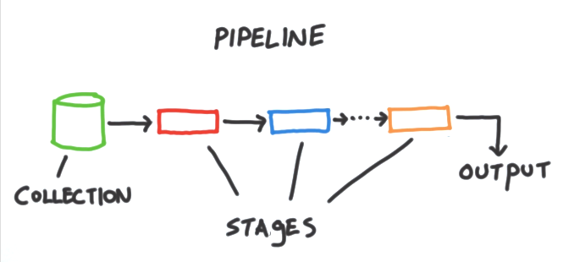
MongoDB Aggregate Framework
Aggregation exceed the filtering capabilities of MQL
Aggregation → Compute, Reshape, Reorganize data
Will not modify or change your original data
db.<collection name>.aggregate( [ { <stage 1> }, { <stage 2> }, ... ] )

Slide 4
MongoDB Aggregate Framework
db.fb1.find( {"Page Name":"eBay"}, {"Page Name":1, "Likes":1})
Aggregation: db.fb1.aggregate( [{$match:{"Page Name":"eBay"}}, {$project:{"Page Name":1, "Likes":1}}])
The order is matter
match
project

Slide 5
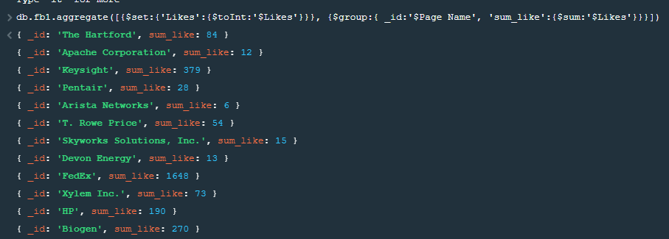
MongoDB Aggregate Framework
Aggregation: $group – separates documents into groups according to a "group key" {$group:{ _id: <expression>, <field 1>: {<accumulator 1>:<expression 1>}, …}}
db.fb1.aggregate([{$set:{'Likes':{$toInt:'$Likes'}}}, {$group:{ _id:'$Page Name', 'sum_like':{$sum:'$Likes'}}}])
db.fb1.aggregate([{$match:{"Page Name":"eBay"}}, {$project:{"Page Name":1,"Likes":1}}, " {$group:{_id: "$Page Name", "sum likes":{$sum:"$Likes"}}}])
$ here indicate the field
!
What is the output?
Order is Matter!

Slide 6
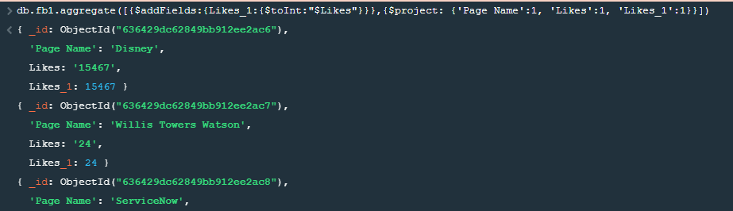
MongoDB Aggregate Framework
Aggregation: $addFields -- Adds new fields to documents { $addFields: { <newField>: <expression>, ... } }
db.fb1.aggregate([{$addFields:{Likes_1:{$toInt:"$Likes"}}},
{$project: {'Page Name':1, 'Likes':1, 'Likes_1':1}}])
db.fb1.aggregate([ {$addFields:{Likes_1:{$toInt:"$Likes"}}}, {$group:{_id:"$Page Name","sum like":{$sum:"$Likes_1"}}} ])

Slide 7
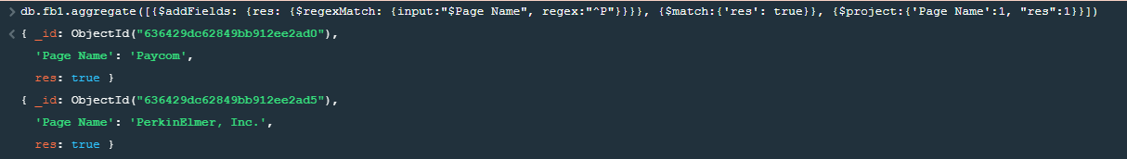
MongoDB Aggregate Framework
Aggregation: $regexMatch -- Performs a regular expression (regex) pattern matching and returns:
true if a match exists.
false if a match doesn't exist. { $regexMatch: { input: <expression> , regex: <expression>, options: <expression> } }
db.fb1.aggregate([{$addFields: {res: {$regexMatch: {input:"$Page Name", regex:"^P"}}}}])
db.fb1.aggregate([{$addFields: {res: {$regexMatch: {input:"$Page Name", regex:"^P"}}}}, {$match:{'res': true}}, {$project:{'Page Name':1, "res":1}}])
How the output looks like?

Slide 8
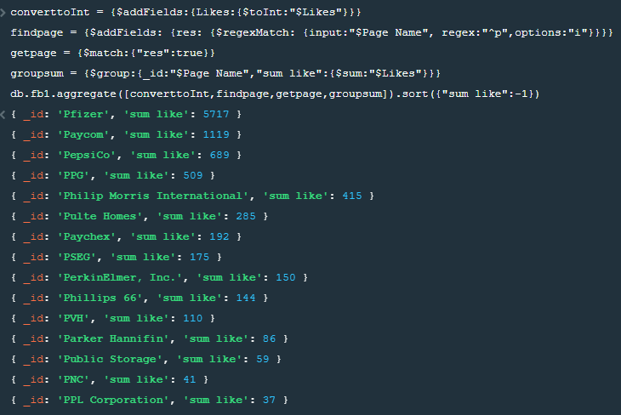
MongoDB Aggregate Framework
Combine what we learn:
converttoInt = {$addFields:{Likes:{$toInt:"$Likes"}}}
findpage = {$addFields: {res: {$regexMatch: {input:"$Page Name", regex:"^p",options:"i"}}}}
getpage = {$match:{"res":true}}
groupsum = {$group:{_id:"$Page Name","sum like":{$sum:"$Likes"}}}
db.fb1.aggregate([converttoInt, findpage, getpage,groupsum]).sort({"sum like":-1})

Slide 9

https://www.mongodb.com/languages/python

Slide 10
Homework
Please use Mongosh in MongoDB Compass and fb_sample_hwk.csv as the dataset to complete the following tasks:
Please convert the data type of “Likes” to Int
Please find out how many posts have “Likes” larger than 5
Please find out how many posts have “Likes” larger than 3 or “Shares” larger than 5, and the output only display the “Page Name”, “Likes”, and “Shares” (If the data type of “Shares” is a string, you need to change the data type of “Shares”)
Please find out the Top 3 Facebook accounts which have the largest number of “Likes” (you need to only display the “Page Name” and “Likes” of these accounts)
[Bonus:5 points] For those accounts with names starting with the letter “P”, please find out the Top 3 Facebook accounts which have largest number of “my total Interactions”. (my total Interactions = “Likes” + “Shares”) (you need to only display the “Page Name” and “my total Interactions” of these accounts).

Slide 11
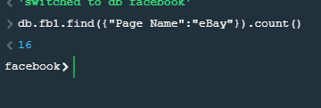
Submission
1. Create a new document in Word
2. For each task, write down the MQL first, and then screenshot MQL & the output in Mongosh.
e.g. Task 0: how many posts from eBay?
db.fb1.find({"Page Name":"eBay"}).count()
3. Submit this .docx file

